Slide 1
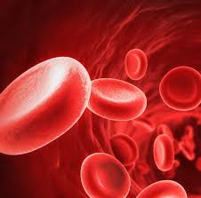
Initiation and termination of massive transfusion protocols Current strategies and future prospects

Slide 3
Introduction
Concern of improper administration of massive transfusions (MTs) led to the development of massive transfusion protocols (MTPs) in the mid to late 2000s.
MTP-guided resuscitation
improvement in overall patient survival, reductions in blood product utilization, and incidence of complications associated with blood product transfusions.

Slide 4
Introduction
As of 2017, MTPs have been widely adopted within the United States.
Vary extensively with the criteria for initiation, the end points for termination, and the indications for therapeutic adjuncts to blood products.

Slide 5
Introduction
Is there sufficient evidence to permit the development of a standardized MTP?
Whether geographic differences in trauma patient demographics would affect the efficacy of a standardized MTP at individual trauma centers.

Slide 6
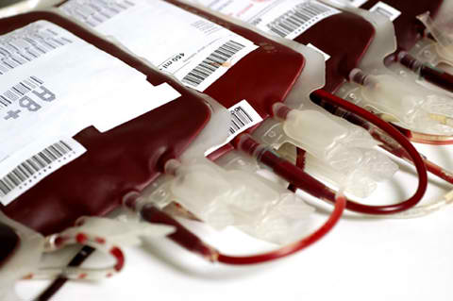
Introduction
Review on 2 contended topics : the decision to initiate an MTP and the decision to terminate.
The comparative strengths and weaknesses of validated approaches to guiding MTP initiation and termination.

Slide 7
Introduction
Supporting references were sourced from respective MTP guidelines published
American Society of Anesthesiologists (ASA)
The American College of Surgeons (ACS)
The European Society for Advanced Bleeding Care in Trauma (ABC-Trauma).

Slide 8
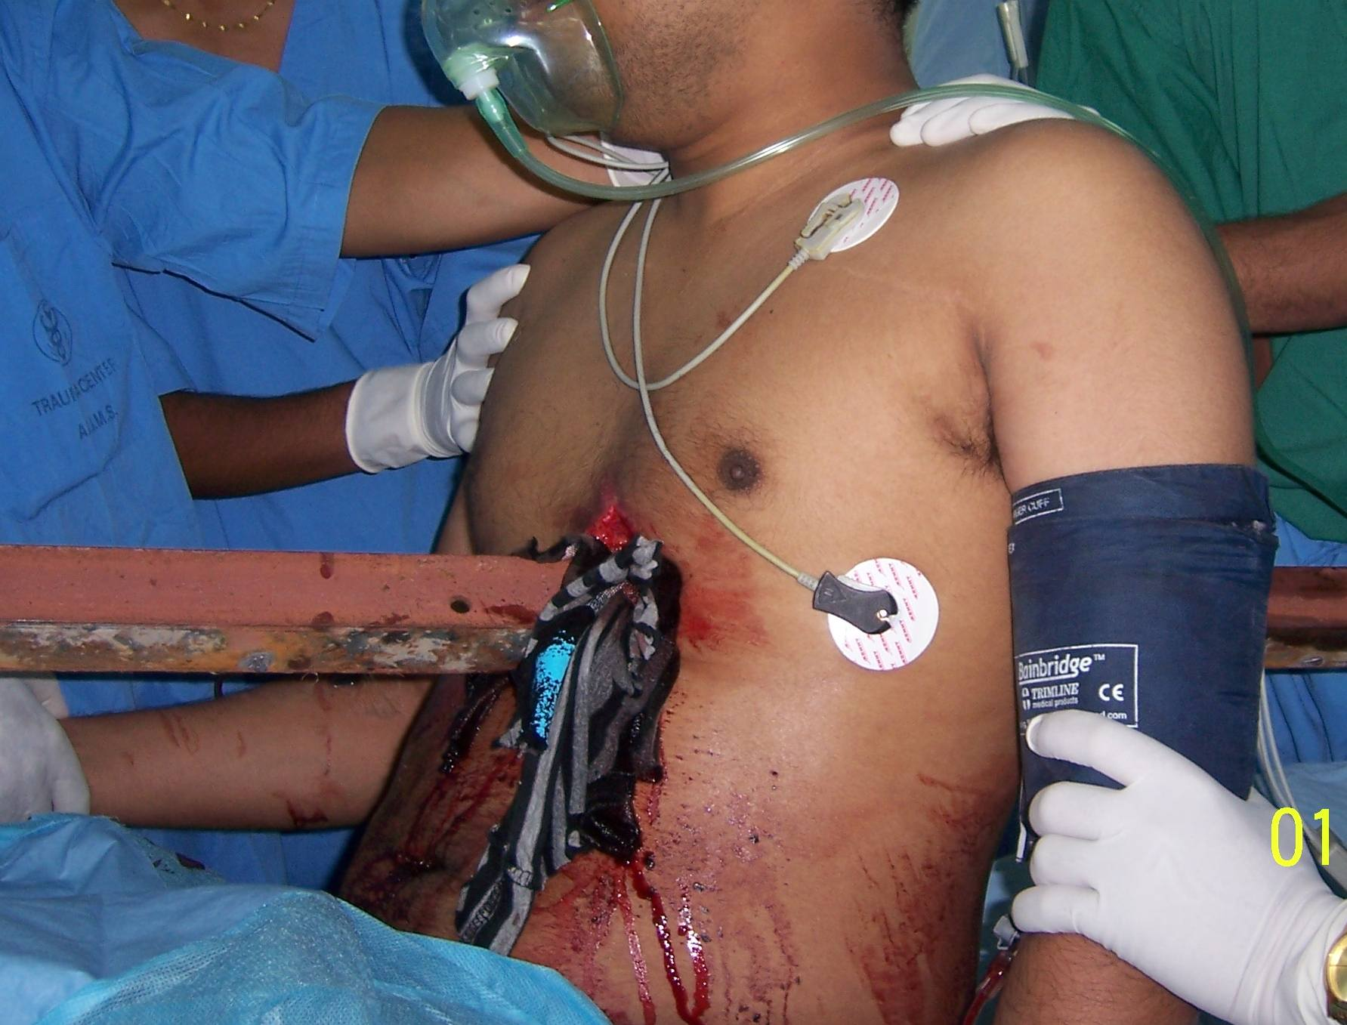
INITIATION OF MASSIVE TRANSFUSION PROTOCOLS

Slide 9
INITIATION OF MASSIVE TRANSFUSION PROTOCOLS
Patient survival during massive hemorrhage is depend on rapid identification and control of the bleeding source.
Patient mortality after massive hemorrhage improves with
decreased time between patient presentation and MTP activation
decreased delays between MTP activation and the initiation of an MTP.

Slide 10
INITIATION OF MASSIVE TRANSFUSION PROTOCOLS
“identification and early resuscitation of patients requiring an MT”

Slide 11
Societal Guidelines
How a physician can quickly and accurately determine whether a hemorrhaging patient requires an MT.
Numerous publications outlining in the decision to initiate an MTP.
MT prediction tools
Estimated blood loss guidelines
Laboratory markers of tissue perfusion
patient’s history and examination

Slide 12
The recommendations for MTP initiation after traumatic injury
Societal Recommendations for Initiation of Massive Transfusion Protocols
American Society of Anesthesiologists Identify patients requiring a massive transfusion with the following: Positive Assessment of Blood Consumption Score Consider the following risk factors when evaluating massive transfusion requirements: Positive Larson Score Blood transfused in the emergency department or trauma bay

Slide 13
The recommendations for MTP initiation after traumatic injury
Societal Recommendations for Initiation of Massive Transfusion Protocols
American College of Surgeons Criteria to trigger a massive transfusion should include 1 or more of the following: Positive Assessment of Blood Consumption Score Immediate surgery or angioembolization necessary for bleeding source control Blood transfused in the emergency department or trauma bay Persistent hemodynamic instability after initial fluid resuscitation

Slide 14
The recommendations for MTP initiation after traumatic injury
Societal Recommendations for Initiation of Massive Transfusion Protocols
Task Force for Advanced Bleeding Care in Trauma The decision to initiate a massive transfusion should consider the following elements: Trauma-Associated Severe Hemorrhage Score Estimated blood loss mechanism and severity of injury Advanced Trauma Life Support guidelines on hemorrhage classification Advanced Trauma Life Support guidelines on response to initial fluid resuscitation

Slide 15
Societal Guidelines
Each guideline combines the clinical assessment of tissue perfusion and estimated blood loss with a validated MT prediction score.
Clinical reasoning to be 65.6% sensitive, 63.8% specific, 34.9%positive predictive value (PPV) and 86.2% negative predictive value (NPV) for predicting MT requirements.
Clinical reasoning alone is insufficient to independently guide the initiation of an MTP

Slide 16
MT Prediction Scores for Guiding MTP Initiation
The ASA and ACS recommend the Assessment of Blood Consumption (ABC) score
4-variable scoring system

Slide 17
Assessment of blood consumption score
variable | value | point
- Systolic blood pressure (mm Hg) - Heart rate (beats/min) - Focused assessment with sonography for trauma examination - Mechanism of injury | ≤90 ≥120 Positive Penetrating | 1 1 1 1
Score range ABC: 0–4 Positive score threshold ABC: ≥2

Slide 18
Assessment of Blood Consumption score
The initial validation of the ABC score was conducted using trauma patient data between 2005 and 2006.
The ABC score correctly predicted need for MT in 84% of cases, with a sensitivity of 75% and specificity of 86%.

Slide 19
Assessment of Blood Consumption score
Revalidation of the ABC score was conducted using trauma patient data at 3 large trauma centers in the United States between 2006 and 2007.
ABC score was 75-90% sensitive and 67%-88% specific with regard to its ability to predict MT requirements within 24 hours of trauma.

Slide 20
Assessment of Blood Consumption score
Advantages of the ABC score
4-scoring variables and cutoff values are easy to recall
rapidly obtained in the prehospital setting and at initial presentation
scoring system can be immediately calculated and interpreted once all variables are obtained.
highly successful in correctly identifying patients who will not require an MT

Slide 21
Assessment of Blood Consumption score
Limitation
The 55% PPV, increased likelihood of blood product wastage and complications associated with blood product transfusions.
Not sensitive for other sources of major bleeding

Slide 22
MT Prediction Scores for Guiding MTP Initiation
The ABC-Trauma guidelines recommend utilizing the Trauma-Associated Severe Hemorrhage (TASH) score for predicting MT risk in trauma patients.

Slide 23
Trauma-Associated Severe Hemorrhage Score
Variable | Value | Points
Systolic blood pressure (mm Hg) Systolic blood pressure (mm Hg) Heart rate (beats/min) Focused assessment with sonography for trauma examination Hemoglobin (g/dL) Hemoglobin (g/dL) Hemoglobin (g/dL) Hemoglobin (g/dL) Hemoglobin (g/dL) | <120 <100 >120 positive <12 <11 <10 <9 <8 | 1 4 2 3 2 3 4 6 8

Slide 24
Trauma-Associated Severe Hemorrhage Score
Variable | Value | Points
Base excess (mMol/L) Base excess (mMol/L) Base excess (mMol/L) Sex Unstable or open fracture Unstable or open fracture | Less than −2 Less than −6 Less than −10 Male Femur Pelvis | 1 3 4 1 3 6
Score range Positive score cutoff | TASH: 0–28 TASH: ≥16

Slide 25
Trauma-Associated Severe Hemorrhage Score
TASH score is a 7-variable, 28-point
Weighted scoring system developed through multivariate analysis of trauma patient data recorded between 1993 and 2003 in German Trauma Society (TR-DGU).

Slide 26
Trauma-Associated Severe Hemorrhage Score
Validation of the score within the TR-DGU ,TASH score was able to correctly classify 88.8% of patients with regard to their MT requirements.
Revalidation of the TASH score in 2004 to 2007 , TASH score was 31% sensitive ,98% specific, PPV of 58.7% and NPV of 93.9% for correctly predicting MT requirements after trauma.

Slide 27
Trauma-Associated Severe Hemorrhage Score
The validation on the TASH score is very similar to the ABC score in that identifies patients who will not require an MT.
Positive score will often incorrectly predict MT requirements in patients who do not require an MT.

Slide 28
Trauma-Associated Severe Hemorrhage Score
Advantages of the TASH score
Ability for users to modify several score parameters
The scoring system to better predict MT requirements specific to the local trauma patient population.
Its potential for a standardized MTP.

Slide 29
Trauma-Associated Severe Hemorrhage Score
Limitation
In the time-sensitive setting of a massive hemorrhage.
Requires 2 laboratory results, hemoglobin and base excess.
Require on average 7:56 minutes to calculate.
Reduces physician compliance and increases the potential for errors in scoring leading to further delays in the initiation of an MTP.

Slide 30
Directly Comparing the MT Prediction Scores
TASH score’s ability to predict MT requirements for trauma patients in the urban United States was very similar to the ABC score.
in 2012, European study using trauma patient data from the TR-DGU database. The TASH score was significantly greater than the ABC score.

Slide 31
Directly Comparing the MT Prediction Scores
Mitra et al using trauma patient data sets from the Australian Royal Prince Alfred trauma registry. The TASH score again significantly greater than the ABC score.

Slide 32
Directly Comparing the MT Prediction Scores
ABC score’s reduced statistical performance measures when calculated with data from outside the urban United States.
Differences between trauma demographics.
Injury Severity
Mean patient age
relative percentage of penetrating mechanisms of injury

Slide 33
Directly Comparing the MT Prediction Scores
Epidemiological data from the TR-DGU
penetrating mechanism as ranging from 4.8% to 5.3%.
approximately 80% are stab wounds
20% are gunshot wounds

Slide 34
Directly Comparing the MT Prediction Scores
The Royal Prince Alfred Hospital in Australia
5.7% of all traumatic injuries having a penetrating mechanism
<1% attributable to gunshot and stab wounds.
the urban Unites States
penetrating mechanism ranges from 18% to 59%.

Slide 35
Directly Comparing the MT Prediction Scores
Mechanism of injury has a significant effect on patient morbidity and mortality.
penetrating trauma have mortality rate higher than blunt mechanism of injury.

Slide 36
Directly Comparing the MT Prediction Scores
Massive endothelial damage
increased risk for hypovolemia
decreased tissue perfusion
combination of the hypothermia, metabolic acidosis, and coagulopathy

Slide 37
Directly Comparing the MT Prediction Scores
Small retrospective study that compared the ABC and TASH scores in a rural United States trauma setting
Effects rural trauma demographics have on the statistical performance of the ABC score is minimal

Slide 38
Initiating MT in the Non-trauma Patient
The percentage of overall MTP activations that occur in non-trauma patients is ranging from 8% to as high as 50%.
MTPs have not been shown to improve patient outcome in this setting.
May relate to the abundance of MTP “overactivations”

Slide 39
Initiating MT in the Non-trauma Patient
Guidelines for guiding MTP initiation in non-trauma patients are imperative.
Scoring systems those utilized in trauma does not benefit in hemorrhaging non-trauma patient.
Glasgow-Blatchford score, new MT prediction scores specific to non-trauma hemorrhage

Slide 41
Initiating MT in the Non-trauma Patient
In cases where blood loss can be measured
to initiate an MTP in all hemorrhaging patients meet criteria for “massive hemorrhage”
utilizing the “intensity of resuscitation”
4 or more units of any blood products, within 30 minutes of arrival had significant increases in 6- and 24-hour mortality rates.

Slide 42
Initiating MT in the Non-trauma Patient
Newer definitions of MT that define it as at least 3–4 units of packed red blood cells (RBCs) per hour.
mortality begins to increase
In the absence of MT prediction scores, resuscitation intensity use for decision to initiate an MTP in the non-trauma setting.

Slide 43
Hemostatic Resuscitation in the Prehospital Setting
Prolonged prehospital transport times are likely responsible for increased patient mortality.
greater with in the setting of massive hemorrhage.
reduce prehospital transport time and transfer delays, implementing guidelines for hemostatic resuscitation in the prehospital setting has significant potential to improve patient survival.

Slide 44
Hemostatic Resuscitation in the Prehospital Setting
Several hospital have researched the use of blood products during prehospital transport.
current level of evidence is low and the results are variable
prehospital transfusion of plasma is associated with improved neurological outcomes, reduced blood product requirements, and improved early mortality.

Slide 45
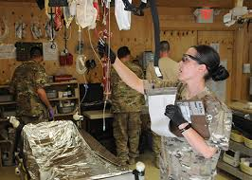
Hemostatic Resuscitation in the Prehospital Setting
Whole blood has also shown mortality benefit in the prehospital setting.
In the military trauma setting, whole blood was shown
decrease mortality
reduce transfusion volumes
better correct coagulation parameters

Slide 46
TERMINATION OF MASSIVE TRANSFUSION PROTOCOLS

Slide 47
TERMINATION OF MASSIVE TRANSFUSION PROTOCOLS
Prolonged resuscitation with large volumes of blood products puts patients at risk for physiologic disturbances and severe complications.
Failure to adequately resuscitate can lead to protracted tissue ischemia, increased bleeding risk, and increased patient mortality.
“evidence-based guidelines for the termination of MTPs”

Slide 48
Societal Guidelines
The Societal Recommendations for Termination of Massive Transfusion Protocols
American Society of Anesthesiologists The following criteria should be met before termination of a massive transfusion: Bleeding source control Stable hemodynamic vital signs

Slide 49
Societal Guidelines
The Societal Recommendations for Termination of Massive Transfusion Protocols
American College of Surgeons The following criteria should be met before termination of a massive transfusion: Bleeding source control Stable hemodynamic vital signs Decreasing vasopressor dependence

Slide 50
The Societal Recommendations for Termination of Massive Transfusion Protocols
Task Force for Advanced Bleeding Care in Trauma The following are recommended resuscitation targets (laboratory result–guided model) : Hemoglobin concentration between 7 and 9 g/dL Prothrombin time and partial thromboplastin time <1.5× normal values

Slide 51
The Societal Recommendations for Termination of Massive Transfusion Protocols
Task Force for Advanced Bleeding Care in Trauma PLT >50 × 109/L (PLT >100 × 109/L in patient with traumatic brain injury or active bleeding) Fibrinogen >1.5–2 g/L No recommendations regarding viscoelastic hemostatic assay parameters

Slide 52
Societal Guidelines
Recommend guiding MTP termination with clinical judgment and the fulfillment of 3 broad criteria
bleeding source control
stable or improving hemodynamic vital signs
decreasing or absent vasopressor requirements

Slide 53
Societal Guidelines
The ABC Trauma guidelines are unique in their recommendation for prompt termination of resuscitation by laboratory test results

Slide 54
Laboratory Testing for Guiding MTP Termination
In patients requiring prolonged resuscitation, MT would benefit from utilizes laboratory results to guide further resuscitation.
Correction of specific abnormalities of hemostasis, reducing unnecessary blood product transfusions.

Slide 55
Laboratory Testing for Guiding MTP Termination
MT literature demonstrating that when laboratory result–guided resuscitation is used
patients require fewer blood products
patient morbidity is reduced
improvement of objective hemostatic markers.

Slide 56
Laboratory Testing for Guiding MTP Termination
“Copenhagen Concept” model of laboratory result–guided resuscitation has been successfully used in Denmark.
ABC-Trauma’s recommend laboratory result–guided resuscitation specifically to use of conventional coagulation assays (CCAs).

Slide 57
Laboratory Testing for Guiding MTP Termination
Viscoelastic hemostatic assays (VHAs) as a method to guided resuscitation are increasing use in hemorrhaging trauma patients.
VHAs have significant potential as they can further elucidate trauma-associated coagulopathy : impaired thrombin generation, impaired clot strength, and aberrant fibrinolysis.

Slide 58
Laboratory Testing for Guiding MTP Termination
VHAs values available within 15 minutes of running the test; in comparison, CCA results can take up to 48 minutes to return.
Fast turnaround times allow for rapid identification and treatment of coagulopathies and lessen the physiological changes.

Slide 59
Laboratory Testing for Guiding MTP Termination
The benefits of VHAs over CCAs were shown in a RCT that compared CCA- and VHA-guided resuscitation
mortality was significantly lower and fewer patients died due to hemorrhage in the VHA group
decreased transfusion of platelets and plasma during the first 2 hours of resuscitation.
Results suggest that VHA-guided resuscitation is superior to CCA-guided resuscitation in hemorrhaging trauma patients.

Slide 60
Laboratory Testing for Guiding MTP Termination
A 2014 systematic review evaluated 55 observational studies on the use of VHAs to diagnose coagulopathy
1 of these observational studies showed no overall difference in between the 2 treatment groups
volume of blood product transfused
ventilator days, intensive care unit days
overall patient mortality

Slide 61
Laboratory Testing for Guiding MTP Termination
VHA-guided resuscitation improved mortality in a cohort of penetrating trauma patients that received more than 10 units of RBCs
VHA-guided resuscitation after trauma may have a beneficial role in patients who
continue to massively hemorrhage.
high risk for tissue hypoperfusion.
trauma-associated coagulopathy.

Slide 63
Conclusions
MTPs has had a significant impact on hemorrhaging trauma patient morbidity and mortality.
Unable to reach the best methods for guiding the initiation and termination of MTPs.

Slide 64
Conclusions
The ABC and TASH scores are recommended by several MTP guidelines for aiding in the decision to initiate an MTP.
Both scoring systems reliably identify patients who do not require an MTP after trauma while demonstrating overpredict MT requirements.

Slide 65
Conclusions
The ABC score’s easy to remember variables, and rapid calculation have made it a prominent component of MTPs in the United States.
The effect that local trauma demographics, the prevalence of penetrating trauma, may have on performance of the ABC score.

Slide 66
Conclusions
Outside of the trauma setting does not benefit from the ability to apply validated MT prediction scores.
Risk prediction scores for guiding the decision to intervene in cases of gastrointestinal hemorrhage are supportive

Slide 67
Conclusions
Further research to guide MTP initiation in the setting of non-trauma hemorrhage is required.
Despite the serious complications with transfusion of large volumes of blood product, the topic of MTP termination has been considered.

Slide 68
Conclusions
MTP termination emphasize clinical reasoning to identify patients with bleeding source control and adequate resuscitation.
The ABC-Trauma’s guidelines present an additional recommendation for prompt termination by laboratory test results.

Slide 69
Conclusions
CCA-guided resuscitation during massive hemorrhage leads to fewer blood product transfusions and improved patient mortality.
Literature on VHAs and their ability to surpass CCAs with regard to identifying and treating coagulopathies

Slide 70
Conclusions
RCTs directly comparing algorithm guided and laboratory result–guided resuscitation methods are needed before further recommendations to guide MTP termination.

